Slide 1
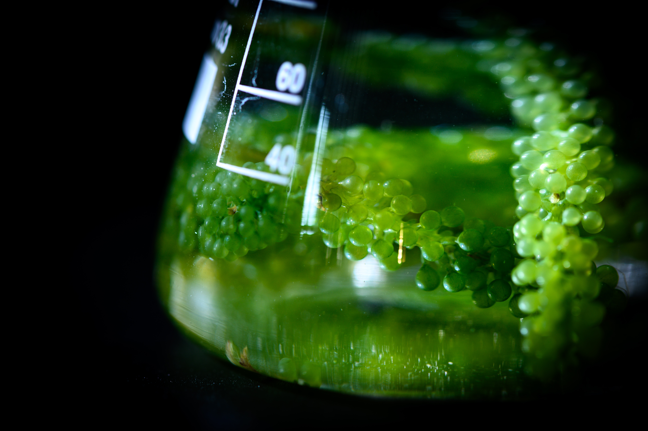
IPE
ALISHA JUNAID, ANNE YANG, CHARLENE YANG, TAIHEI EASTWOOD, VINCENT YE.
MAKING PATENTS
SIMPLE FOR EVERYONE.
BUILDATHON 2025 FALL

Slide 2
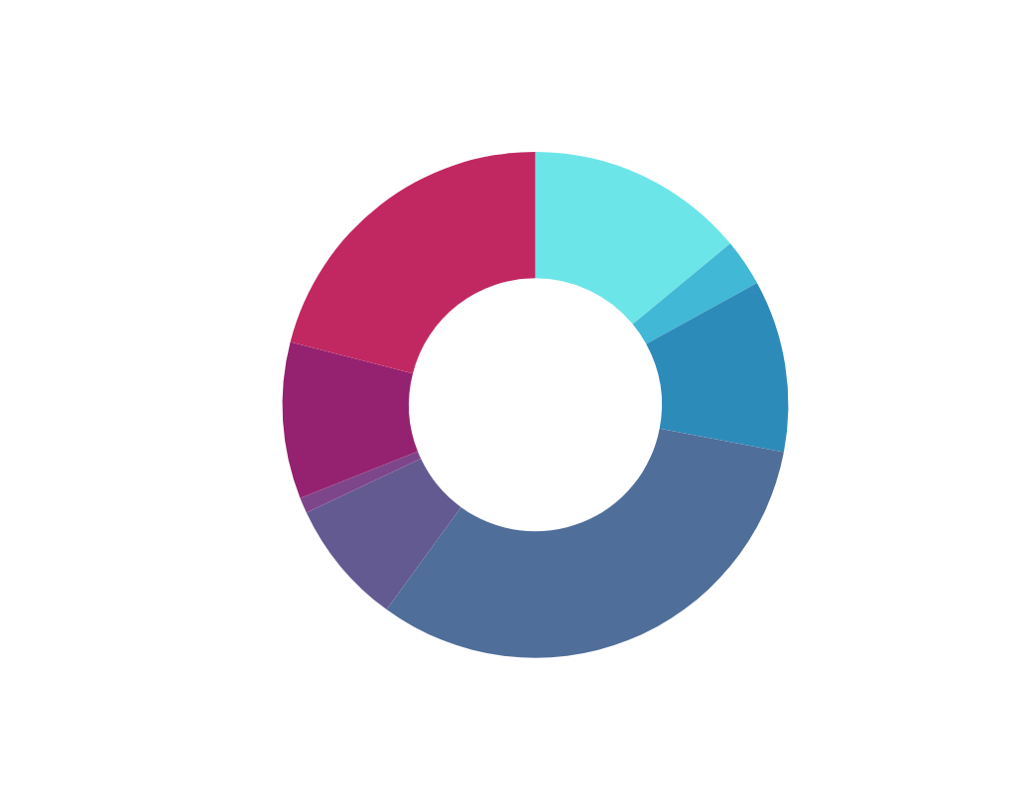
Problem
TOTAL PATENT COST: $56,525
BioTech founders and researchers are often lost in the patent process.
The process costs anywhere from 30-60k per patent and requires specialized knowledge on the formatting.
If formatted incorrectly it could lead to the patent instantly getting rejected
It is hard to track and manage your patent as well as start the creation process.
IPE
Notes:
Alisha : I want problem statement , quote data points of biotech and how hard it is

Slide 3

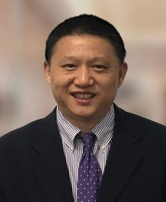
INTERVIEWEES
MARTIN Z. ZHANG - PATENT LAWYER
HONG YU - INVESTER & RESEARCHER
Patent attorney with deep experience in portfolio strategy, patent prosecution, and IP analysis, built on a decade of drug discovery research at Pfizer. He specializes in chemistry, life sciences, pharmaceuticals, and related technologies.
President of Harvard Apparatus Regenerative Technology, is an experienced executive with expertise in strategic analytics and investment research. He spent nearly 20 years at Bank of America as Senior VP and has strong connections in biotech, healthcare, finance, and AI.
Notes:
Anne: The interview validation

Slide 4
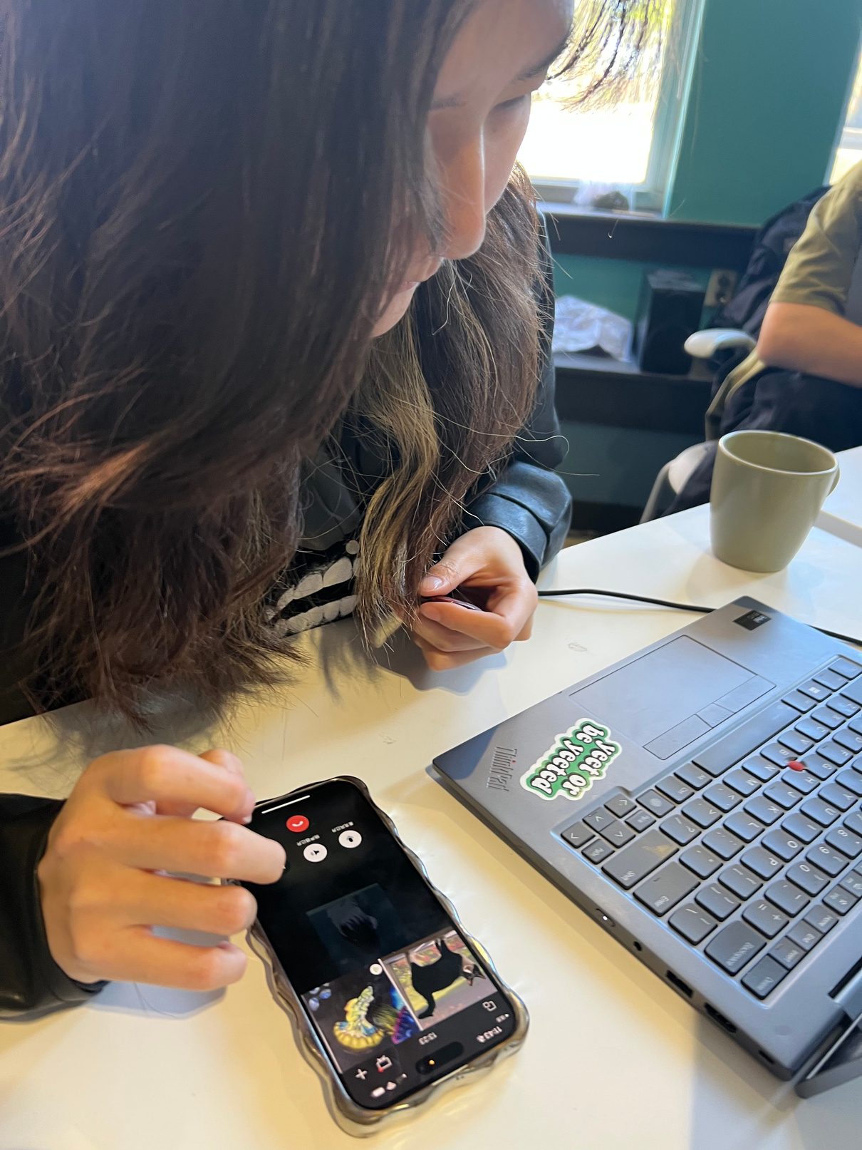

Findings
Patent Filing brings
high barriers, high costs.
PATENTS ARE THE BACKBONE OF BIOTECH
TEAMS MUST FILE PATENTS BEFORE PUBLISHING WORKS (1.5-4 YEARS)
R&D IS EXPENSIVE WITH EARLY STAGE DEVELOPMENT ~$20-100M
ROUGHLY 75% OF PATENTS ARE GRANTED AFTER FILE
TEAM MEMBER DOING REASEARCH CALLS
Notes:
Anne:
A 2024 study found the median cost of developing a new drug at ~$150 million direct R&D spend, and average ~$1.3 billion when including wider costs.
RAND Corporation
+1
A report by Deloitte found that the average cost of developing a new drug among top biopharmas reached approx. US$2.3 billion, a 15% increase year-over-year.
GEN
The Harvard USPTO Patent Dataset includes over 4.5 million U.S. patent applications filed between 2004 and 2018, enabling detailed analysis of filing behaviour and decision outcomes.
arXiv

Slide 5
IPE
an AI patent manager.
1. GUIDED WORKFLOW:
2. SMART DRAFTING
3. TRACEABILITY
Step-by-step patent prep starting with ADS and invention details.
AI helps write and refine abstracts, claims, and terminology—interactive, not fully automated.
Links claims to supporting data for compliance and clarity.
WHAT MAKES US DIFFERENT:
We don’t replace lawyers—we empower teams with structured guidance, biotech-specific terminology, and transparency at the earliest, most critical stage.
Notes:
Taihei
Our awesome concept

Slide 6
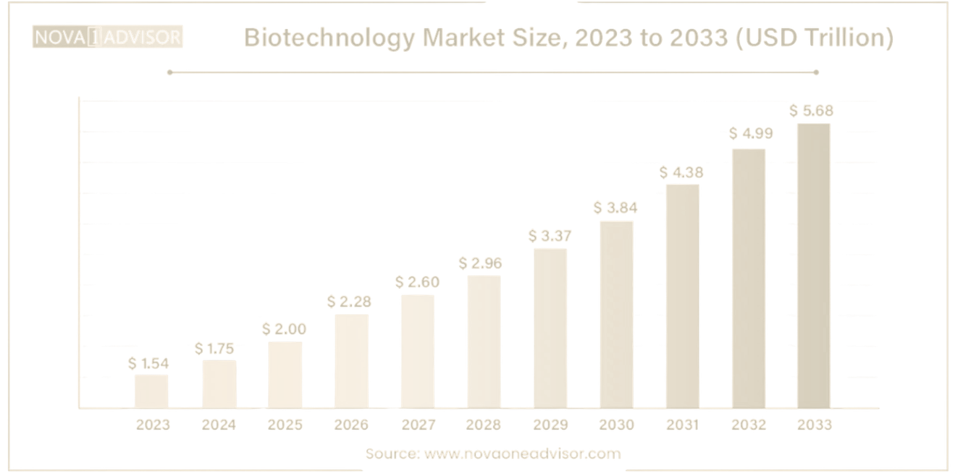
Target Market/ Business Model
TAM — Total Addressable Market
Global early-stage + small biotech companies needing IP support
Estimated ~30,000+ active preclinical → Series B biotech ventures worldwide, Average annual IP spend: $50k–$250k per company
TAM ≈ $3–6B/year (IP filing + management software & legal services)
A SOFTWARE SUBSCRIPTION TO EARLY-STAGE TO SMALL SIZED BIOTECH COMPANIES
SAM — Serviceable Available Market
Biotech companies in the U.S. + EU actively filing patents
~12,000–15,000 startups in regulated markets, Likely to adopt software tools for drafting, data prep, and IP management
SAM ≈ $900M–$1.5B/year
SOM — Serviceable Obtainable Market (Initial Target)
Early-stage teams (1–20 researchers) without a legal team
~3,000–5,000 biotech startups in the U.S. alone, Highly cost-sensitive, already using ChatGPT
SOM ≈ $45M–$75M/year (realistic 5% market capture in 3–5 yrs)
Notes:
Alisha

Slide 7
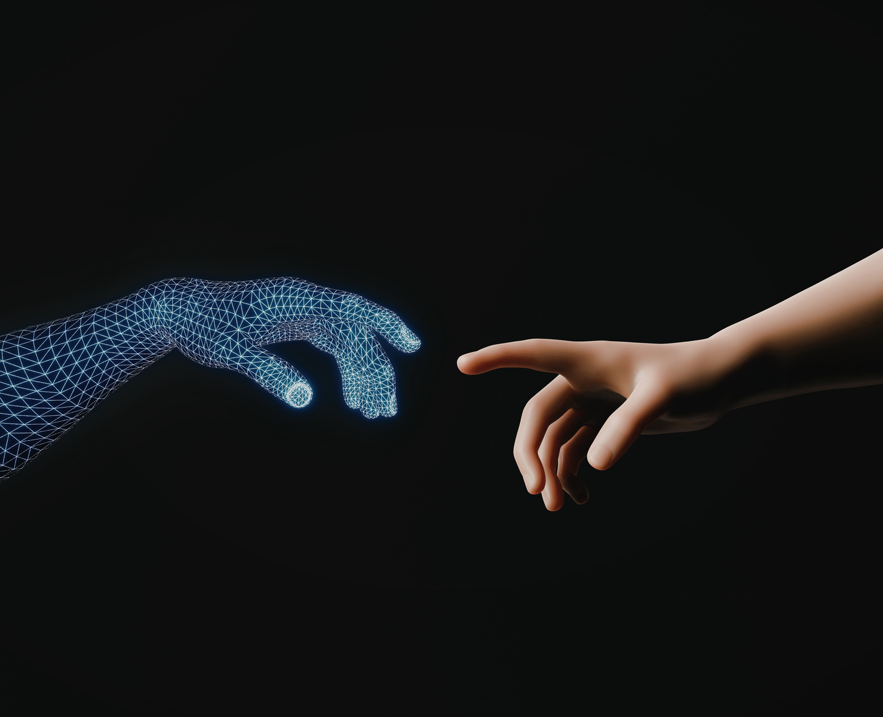
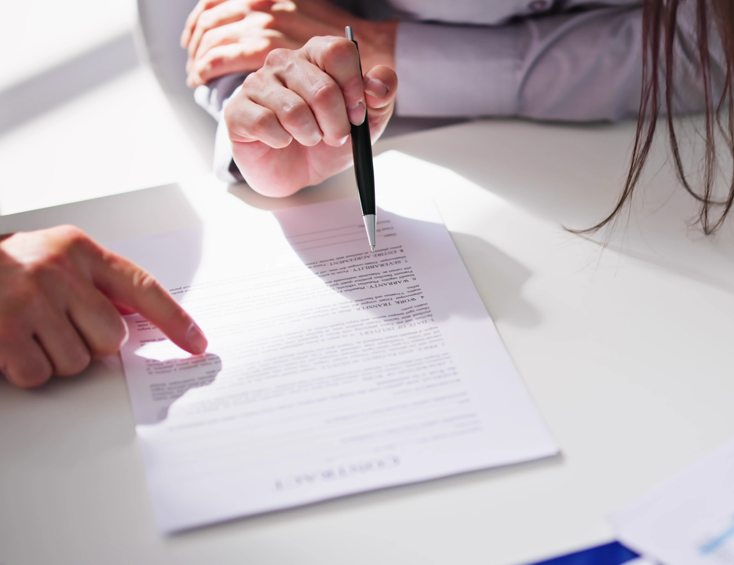

Competitors
CHATGPT
PATENT LAWYER
PATENT BOTS
Lack of data integrity
High cost
Unreliable
Notes:
Alisha

Slide 8
Original ML Patent Analyzer
DATA SOURCING
2. DATA CLEANING
3. NLP PROCESSING
Harvard USPTO Patent Dataset on Hugging Face. Real research graded dataset
Filtered out junk. Found Pass/Fail Labels. Convert into 0s and 1s for XGBoost
Using TfidfVectorizer we turn patent raw text into numbers. Using n-gram(1,3) we make sure it doesn't just see the word "concept"; it also sees "theoretical concept"
4. TRAINING ENGINE 1 (XGBOOST)
5. EVALUATION
6. SHAP (SHAPLEY ADDITIVE EXPLANATIONS
Then we train the XGBoost over 22000 real patent applications and results. We explicitly set objective='binary:logistic' to tell it to predict "Pass" vs. "Fail"
Our model trained successfully and achieved over 80% accuracy on the 2,100+ testing data
Used shap.TreeExplainer to analyze your XGBoost model. This "cracks open the black box" and finds the exact numerical impact of every single word. It's what allows the tool to find that the word "invention" was responsible for a -0.239 drop in the score. This is the mathematical proof that an LLM can't provide.
7. ENGINE 2 (LLM)
This is to make SHAP more readable
Notes:
Vincent

Slide 9
SAMPLE OUTPUTS
-------------------------------------------------
--- SCANNING DRAFT: 'A SYSTEM FOR DATA PROCESSING IS DISCLOSED, AN EMBODIMENT OF ...' ---
[✓] PREDICTION: 77.97% CHANCE OF SUCCESS
--- PERSONALIZED FEEDBACK REPORT ---
[+] TOP 5 DRIVERS OF SUCCESS FOR THIS DRAFT:
- 'MEMORY' (PUSHES SCORE UP BY 0.0120)
- 'DATA PROCESSING' (PUSHES SCORE UP BY 0.0060)
- 'DISCLOSED EMBODIMENT' (PUSHES SCORE UP BY 0.004)
- 'PROCESSING' (PUSHES SCORE UP BY 0.001)
- 'PROCESSOR MEMORY' (PUSHES SCORE UP BY 0.001)
[!] TOP 5 DRIVERS OF FAILURE FOR THIS DRAFT:
- 'EMBODIMENT' (PUSHES SCORE DOWN BY -0.007)
- 'DISCLOSED' (PUSHES SCORE DOWN BY -0.005)
- 'PROCESSOR' (PUSHES SCORE DOWN BY -0.001)
- 'COMPRISES' (PUSHES SCORE DOWN BY -0.000)
- 'DATA' (PUSHES SCORE DOWN BY -0.000)
SUGGESTION:
THIS DRAFT LOOKS STRONG! THE NEGATIVE DRIVERS ARE NOT SIGNIFICANT. REPHRASE WORDS SUCH AS “DATA” “PROCESSOR”
Notes:
Vincent

Slide 10
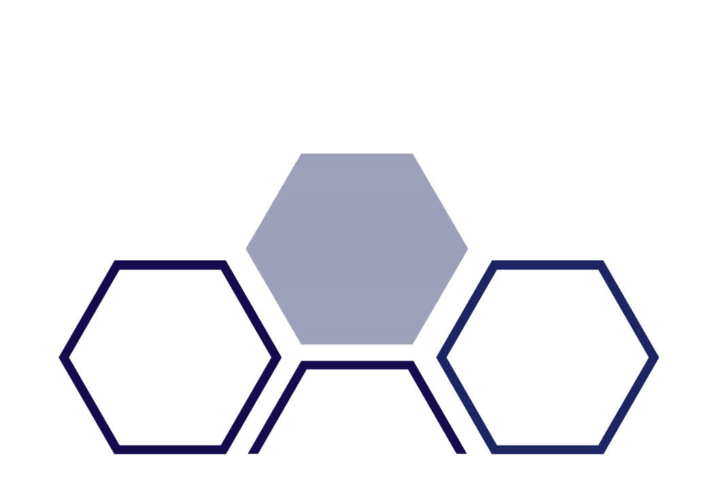
DEMO.

Slide 11
MAKING PATENTS
SIMPLE FOR EVERYONE.
Thank You.

